Slide 1
Phoenix LiveView & Pubsub
For real time and scalable web app
(by Ohhi.vn team)

Slide 2
About team & me
Ohhi.vn team
Started in 2022, first project from 2023.
Target about Elixir/Erlang ecosystem & try to make new things.
Team has contributed 2 open source projects.
Me
Former core team (Antivirus product) of CMC CyberSecurity. Author of CMC CryptoSHIELD (a ransomware protector).
Former Sr. Erlang developer (& training Erlang for new members) of DEK.
Developing high performance rule based detection engine & network graph engine (by Golang) for new SOC (Security Operations Center).

Slide 3
LiveView - Introduce
Stateful page for easy develop.
LiveView is difference with MVC (regular Phoenix page).
Server-rendered HTML (handle by a process).
Fault tolerance already (Yes, we can sleep well).

Slide 4
LiveView - Concept
LiveView (in server side) is a process.
Handle event (client, other processes)
Calculate difference for update
Send update to client.
Client use JS:
Update DOM for diff data from server.
Push events to server.

Slide 5
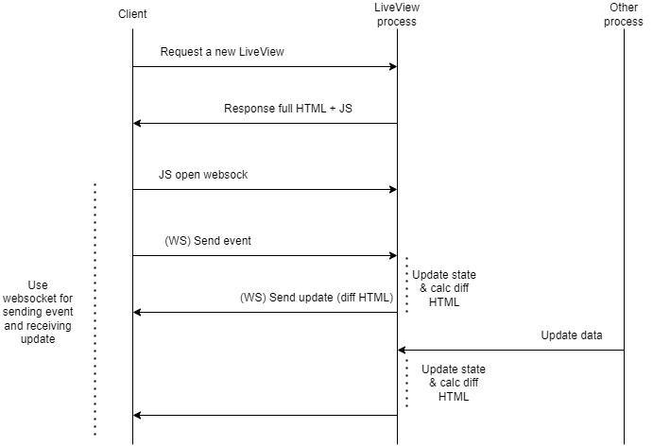

Slide 6
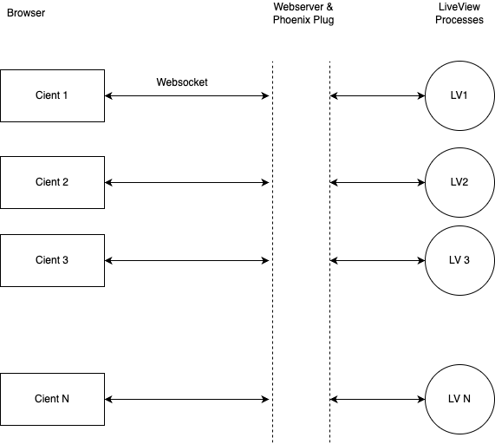

Slide 7
LiveView - Concept
LiveView has three main event:
1. Mount for init state & verify/authen (if don’t use plug).
2. render for render html (render first full html page, then just diff html).
3. handle_event handle events from client.
Opts:
handle_info (handle msg from other/self).
terminate for clean up/save state.

Slide 8
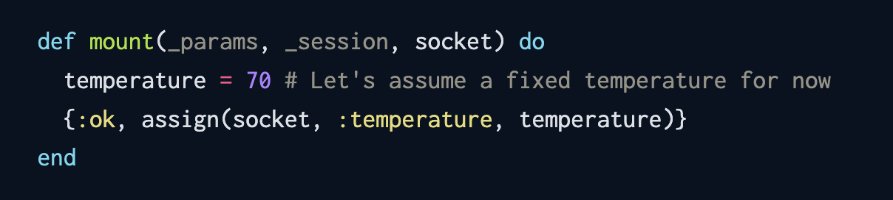
LiveView - Concept - Mount
Where to verify user, get query session.
Init the first time for page (full html page).

Slide 9
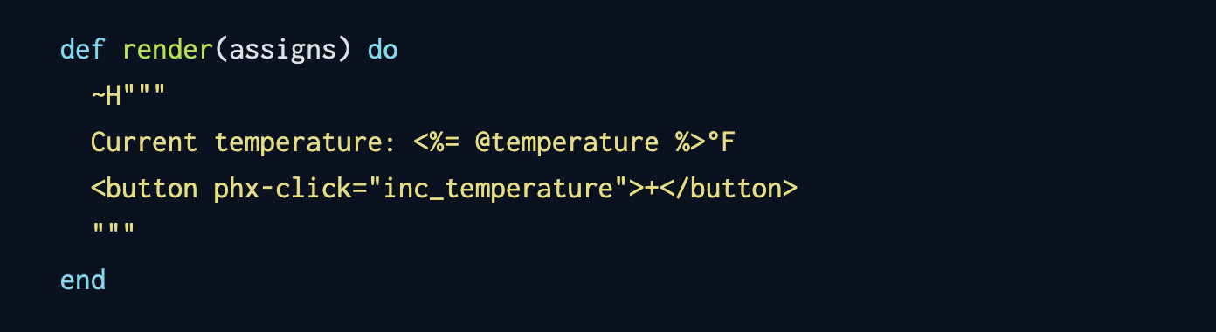
LiveView - Concept - Render
Render full html page for the first time.
Render diff content for next time.
An EEx engine - Smart & Fast evaluate code in inside string.

Slide 10
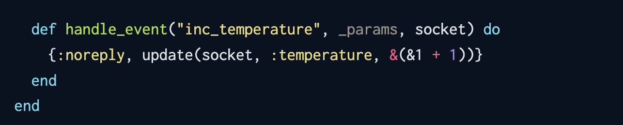
LiveView - Concept - Handle_event
Handle events from client.
Handle events from other processes.
After new value was setted to socket LiveView will check different and push update to client.

Slide 11
LiveView - Some docs maybe help you
Getting Started with Phoenix LiveView
The Lifecycle of a Phoenix LiveView
How EEx Turns Your Template Into HTML | Mitchell Hanberg
Phoenix LiveView JavaScript Hooks and Select2

Slide 12
PubSub - Introduce
A Phoenix library, can use for not a Phoenix app.
Use for send messages between processes on local or across a cluster.
Don’t like send message between processes, Pubsub don’t need to know who will receive (yes, reduce complexity on develop).
We can use third party dispatcher or self develop.

Slide 13
PubSub - How to use
Add deps (mix.exs) & a supervisor (ex: Application’s supervisor):
{:phoenix_pubsub, "~> 2.1"}
{Phoenix.PubSub, name: Trading.PubSub}
Subscribe/Unsubscribe a topic:
PubSub.subscribe(:pubsub_name, “topic_name”)
PubSub.unsubscribe(:pubsub_name, “topic_name”)
Broadcast a message:
PubSub.broadcast(:pubsub_name, “topic_name”, {:greeting, “hello”})
Handle event from PubSub:
handle_info({:greeting, content}, state)

Slide 14
PubSub - Docs
Distributed Phoenix Chat with PubSub PG2 adapter
https://threadreaderapp.com/thread/1421126817373507584.html

Slide 15
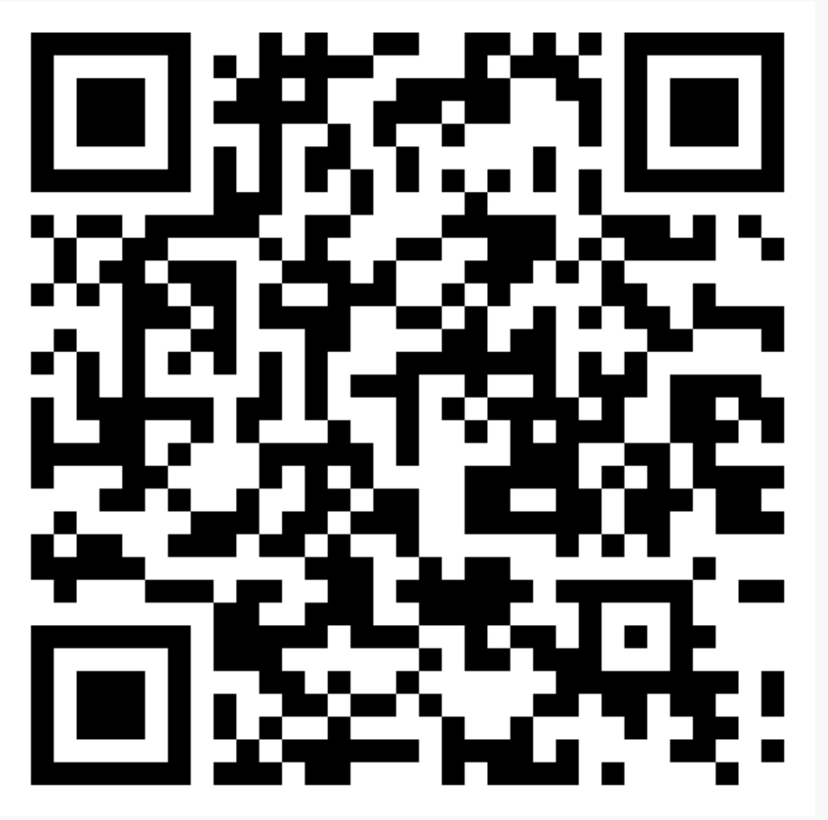
LiveView - Stock Dashboard
Two Elixir app:
Frontend service uses Phoenix LiveView for dashboard, subscribes Phoenix PubSub for getting changed price from Trading service.
Trading service, a stock price simulator.
Repo: https://github.com/ohhi-vn/live_pub_demo

Slide 16
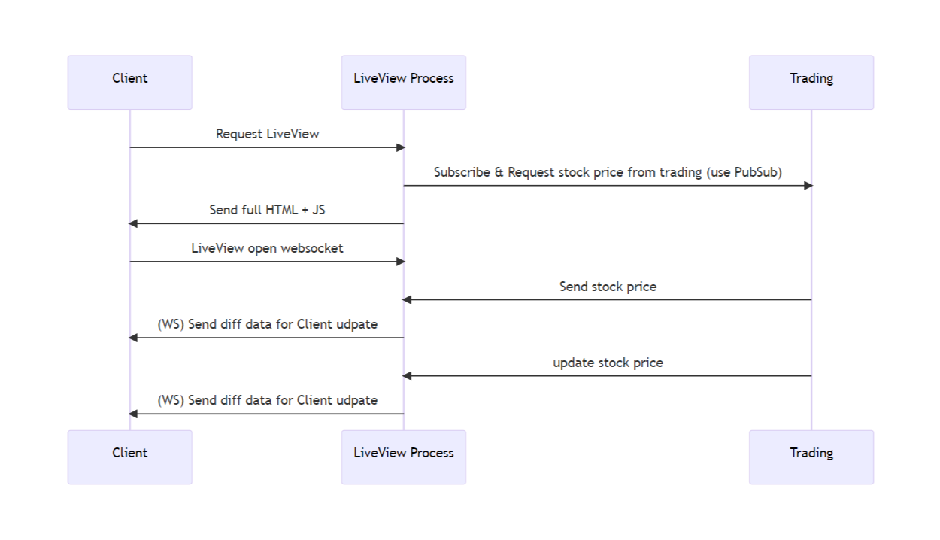
Simple flow of events in Demo

Slide 17
Q & A
Time for Q/A & discussing!

Slide 18
Thank you!
Hope to see you in our next sharing session!
Next topic?
Macro(meta programming) in Elixir & how it works?
Deep dive to Phoenix framework.
An introduce Nx & Axon in Elixir. An advantage stack (frontend/backend, data analysis, ML/DL).
Build a distributed system with Elixir.
Passwordless authentication & Single Sign On (SSO) solution by WebAuthn & OAuth2 (demo with Elixir).
Or somethings else?

